Slide 1
DATA SCIENCE BOOTCAMP
Session 1: Data Science Terms | Jupyter Notebook Demo
Copyright © 2020 Exceed Philippines. All rights reserved

Slide 2
SESSION 1 OUTLINE
DATA SCIENCE TERMINOLOGIES
MACHINE LEARNING AND ITS PROCESS
SUPERVISED VS UNSUPERVISED LEARNING
Copyright © 2020 Exceed Philippines. All rights reserved

Slide 3
SESSION 1 OUTLINE
DATA SCIENCE TERMINOLOGIES
MACHINE LEARNING AND ITS PROCESS
SUPERVISED VS UNSUPERVISED LEARNING
Copyright © 2020 Exceed Philippines. All rights reserved

Slide 4
DATA SCIENCE TERMINOLOGIES: REPORTS
The system reporting tool gives you the ability take periodic full, or partial, snapshots of the system, and save them for future reference.
Copyright © 2020 Exceed Philippines. All rights reserved
docs.magneto.com

Slide 5
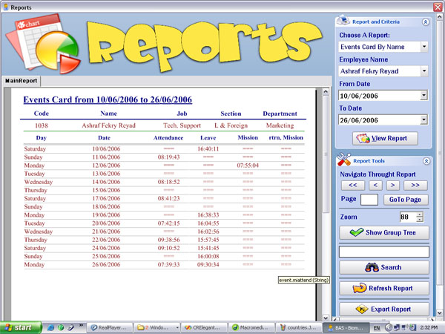
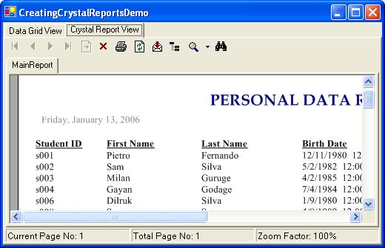
DATA SCIENCE TERMINOLOGIES: REPORTS
Copyright © 2020 Exceed Philippines. All rights reserved
Google Images: “Reports”

Slide 6
DATA SCIENCE TERMINOLOGIES: ANALYTICS
Analytics is the scientific process of discovering and communicating the meaningful patterns which can be found in data.
Copyright © 2020 Exceed Philippines. All rights reserved
Technopedia

Slide 7
DATA SCIENCE TERMINOLOGIES: ANALYTICS
Analytics is the scientific process of discovering and communicating the meaningful patterns which can be found in data.
Copyright © 2020 Exceed Philippines. All rights reserved
Technopedia

Slide 8
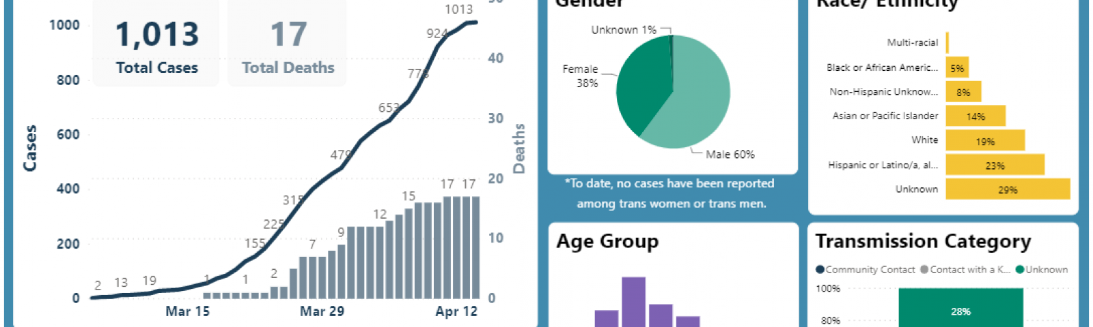
DATA SCIENCE TERMINOLOGIES: ANALYTICS
Copyright © 2020 Exceed Philippines. All rights reserved
Google Images: “Analytics covid 19”

Slide 9
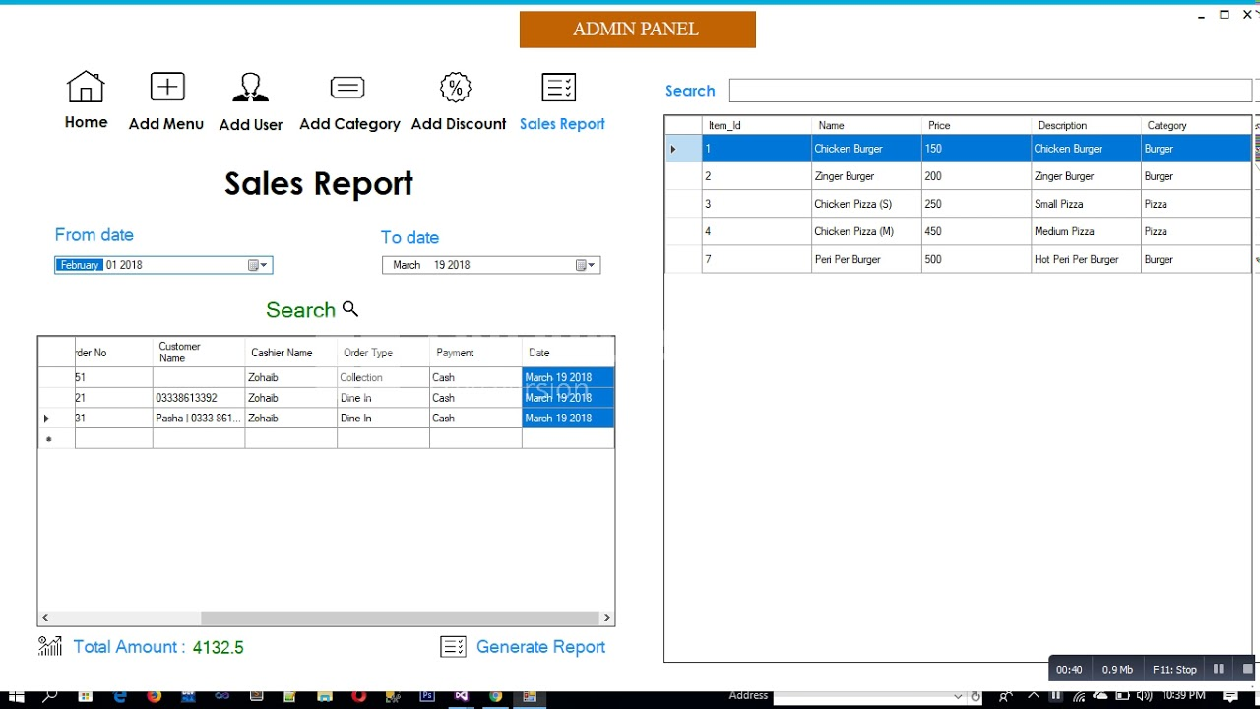
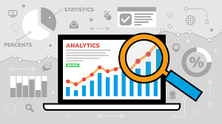
DATA SCIENCE TERMINOLOGIES: REPORTS VS ANALYTICS
From historical data to insights via Dashboard
Copyright © 2020 Exceed Philippines. All rights reserved
Google Images: “system reports C#”

Slide 10
DATA SCIENCE TERMINOLOGIES: BIG DATA
Big Data is a collection of data that is huge in volume, yet growing exponentially with time. It is a data with so large size and complexity that none of traditional data management tools can store it or process it efficiently.
Copyright © 2020 Exceed Philippines. All rights reserved
guru99

Slide 11
DATA SCIENCE TERMINOLOGIES: BIG DATA
Big Data is a collection of data that is huge in volume, yet growing exponentially with time. It is a data with so large size and complexity that none of traditional data management tools can store it or process it efficiently.
Copyright © 2020 Exceed Philippines. All rights reserved
guru99

Slide 12
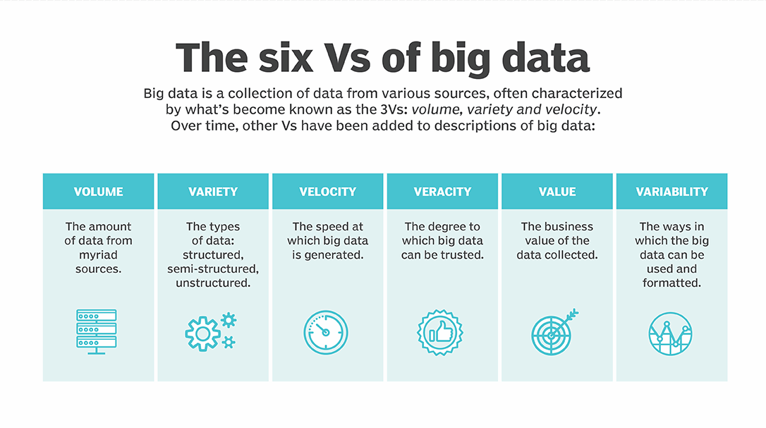
DATA SCIENCE TERMINOLOGIES: 6Vs BIG DATA
Copyright © 2020 Exceed Philippines. All rights reserved
Google Images: “big data”

Slide 13
DATA SCIENCE TERMINOLOGIES: DATA SCIENCE
Data science is a field of applied mathematics and statistics that provides useful information based on large amounts of complex data or big data.
Investopedia
Copyright © 2020 Exceed Philippines. All rights reserved

Slide 14
DATA SCIENCE TERMINOLOGIES: DATA SCIENCE
Data science is a field of applied mathematics and statistics that provides useful information based on large amounts of complex data or big data.
Investopedia
Copyright © 2020 Exceed Philippines. All rights reserved

Slide 15
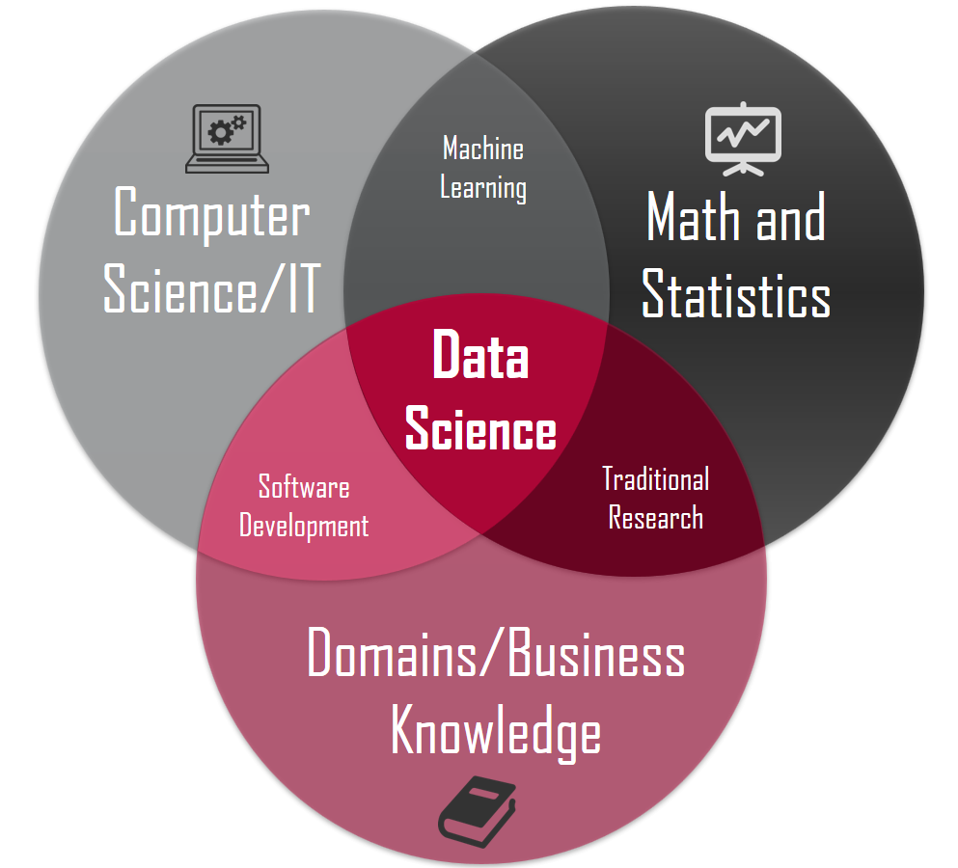
DATA SCIENCE TERMINOLOGIES: DATA SCIENCE
Copyright © 2020 Exceed Philippines. All rights reserved
Google Images: “data science”

Slide 16
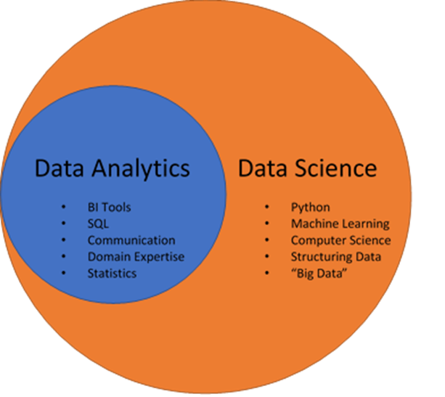
DATA SCIENCE TERMINOLOGIES: DATA SCIENCE VS ANALYTICS
ANALYTICS
DATA SCIENCE
INSIGHTS FROM THE PAST
UTILIZING DATA FROM THE PAST FOR FUTURE
Copyright © 2020 Exceed Philippines. All rights reserved
Google Images: “analytics vs data science”

Slide 17
DATA SCIENCE TERMINOLOGIES: DATA SCIENCE VS ANALYTICS
DESCRIPTIVE ANALYTICS
PREDICTIVE ANALYTICS
WHAT HAPPENED?
WHAT WILL HAPPEN?
DIAGNOSTIC ANALYTICS
PRESCRIPTIVE ANALYTICS
WHY IT HAPPENED?
WHAT SHOULD HAPPEN?
ANALYTICS
DATA SCIENCE
INSIGHTS FROM THE PAST
UTILIZING DATA FROM THE PAST FOR FUTURE
Copyright © 2020 Exceed Philippines. All rights reserved
Analytiks Bootcamp

Slide 18
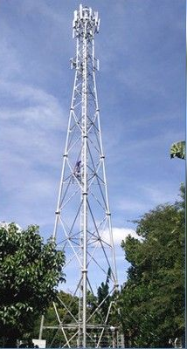
DATA SCIENCE TERMINOLOGIES: DATA SCIENCE VS ANALYTICS
DESCRIPTIVE ANALYTICS
PREDICTIVE ANALYTICS
SITE DOWN!!
(WHAT HAPPENED?)
NOTIFICATION ALERT: SITE A WILL GO DOWN
(WHAT WILL HAPPEN)
DIAGNOSTIC ANALYTICS
PRESCRIPTIVE ANALYTICS
SITE TRAFFIC – MANY SERVICE CONNECTED
(WHY IT HAPPENED?)
RECOMMENDED ACTION: CHECK THE SERVICE CONFIGURATION LIMIT
(WHAT SHOULD HAPPEN?)
ANALYTICS
DATA SCIENCE
INSIGHTS FROM THE PAST
UTILIZING DATA FROM THE PAST FOR FUTURE
Copyright © 2020 Exceed Philippines. All rights reserved
Google Images “Cellsite Internet”

Slide 19
DATA SCIENCE TERMINOLOGIES: ANALYTICS – BUSINESS INTELLIGENCE
Business intelligence combines business analytics, data mining, data visualization, data tools and infrastructure, and best practices to help organizations make more data-driven decisions.
Copyright © 2020 Exceed Philippines. All rights reserved
Tableau.com

Slide 20
DATA SCIENCE TERMINOLOGIES: ANALYTICS – BUSINESS INTELLIGENCE
Business intelligence combines business analytics, data mining, data visualization, data tools and infrastructure, and best practices to help organizations make more data-driven decisions.
Copyright © 2020 Exceed Philippines. All rights reserved
Tableau.com

Slide 21
DATA SCIENCE TERMINOLOGIES: ANALYTICS – BUSINESS INTELLIGENCE
Business intelligence combines business analytics, data mining, data visualization, data tools and infrastructure, and best practices to help organizations make more data-driven decisions.
Tools: Tableau, PowerBI, Google Data Studio
Copyright © 2020 Exceed Philippines. All rights reserved
Tableau.com

Slide 22
DATA SCIENCE TERMINOLOGIES: DATA SCIENCE – STATISTICAL METHODS
Statistical methods are mathematical formulas, models, and techniques that are used in statistical analysis of raw research data.
Copyright © 2020 Exceed Philippines. All rights reserved
nature.com

Slide 23
DATA SCIENCE TERMINOLOGIES: DATA SCIENCE – STATISTICAL METHODS
Statistical methods are mathematical formulas, models, and techniques that are used in statistical analysis of raw research data.
Copyright © 2020 Exceed Philippines. All rights reserved
nature.com

Slide 24
DATA SCIENCE TERMINOLOGIES: DATA SCIENCE – STATISTICAL METHODS
Demo: Excel
y=mx+b
Where:
m = slope
b = intercept
x = independent
y = dependent
Copyright © 2020 Exceed Philippines. All rights reserved

Slide 25
DATA SCIENCE TERMINOLOGIES: DATA SCIENCE – MACHINE LEARNING
Machine learning is a branch of artificial intelligence (AI) and computer science which focuses on the use of data and algorithms to imitate the way that humans learn, gradually improving its accuracy.
Copyright © 2020 Exceed Philippines. All rights reserved
IBM

Slide 26
DATA SCIENCE TERMINOLOGIES: DATA SCIENCE – MACHINE LEARNING
Machine learning is a branch of artificial intelligence (AI) and computer science which focuses on the use of data and algorithms to imitate the way that humans learn, gradually improving its accuracy.
Copyright © 2020 Exceed Philippines. All rights reserved
IBM

Slide 27






JANE
HP
TARZAN
HP
What will
TARZAN do?
Give a ROCK.
A wild JANE appeared!!
Opening COMPUTER…
I choose you TARZAN (COMPUTER)!!
Give a FLOWER.
Copyright © 2020 Exceed Philippines. All rights reserved
Notes:
Imagine, TARZAN is a COMPUTER
He grew in a deserted place so he never seen a WOMAN in his life.
But one day, JANE arrives on the island.
NOTE: TARZAN never dated, so he doesn’t know what WOMEN like.

Slide 28
JANE
HP
TARZAN
HP
Give a ROCK.
TARZAN (COMPUTER) gives her a ROCK.
JANE doesn’t like that!
Give a FLOWER.
Copyright © 2020 Exceed Philippines. All rights reserved
Notes:
TARZAN gives her a rock, and JANE doesn’t like that.

Slide 29

JANE
HP
TARZAN
HP
What will
TARZAN do?
Give a ROCK.
JANE likes it!!
TARZAN (COMPUTER) gives her a FLOWER.
Give a FLOWER.
Copyright © 2020 Exceed Philippines. All rights reserved
Notes:
But when TARZAN gives HER a flower, it makes HER happy.

Slide 30
JANE
HP
TARZAN
HP
Catch a SNAKE
TARZAN (COMPUTER) catches a SNAKE for JANE.
What will
TARZAN do?
JANE doesn’t like that!
Give a CUTE RABBIT.
Copyright © 2020 Exceed Philippines. All rights reserved
Notes:
The next day, TARZAN catches a snake for JANE, but JANE didn’t like it.

Slide 31
JANE
HP
TARZAN
HP
What will
TARZAN do?
Catch a SNAKE
TARZAN (COMPUTER) gives her a CUTE RABBIT.
JANE likes it!!
Give a CUTE RABBIT.
Copyright © 2020 Exceed Philippines. All rights reserved
Notes:
Another day, TARZAN gives her a cute rabbit, and that makes JANE happy.

Slide 32
JANE
HP
TARZAN
HP
What will
TARZAN do?
YELLS
JANE doesn’t like that!
TARZAN (COMPUTER) yells at JANE.
SMILE
Copyright © 2020 Exceed Philippines. All rights reserved
Notes:
And when TARZAN yells, JANE is displeased.

Slide 33
JANE
HP
TARZAN
HP
What will
TARZAN do?
YELLS
TARZAN (COMPUTER) smiles at JANE.
JANE likes it!!
SMILE
Copyright © 2020 Exceed Philippines. All rights reserved
Notes:
But when TARZAN smiles, JANE likes it <3

Slide 34

TARZAN learns
how to win
JANE’s heart
Copyright © 2020 Exceed Philippines. All rights reserved
Notes:
While building such experiences…
Hence, the term Machine Learning, you teach the MACHINE (COMPUTER) = TARZAN how to learn.
You give the computer data on various experiences. It will learn the data through predict results

Slide 35
DATA SCIENCE TERMINOLOGIES: DATA SCIENCE – DEEP LEARNING
Deep Learning is a subfield of machine learning concerned with algorithms inspired by the structure and function of the brain called artificial neural networks.
Copyright © 2020 Exceed Philippines. All rights reserved
machinelearningmastery

Slide 36
DATA SCIENCE TERMINOLOGIES: DATA SCIENCE – DEEP LEARNING
Deep Learning is a subfield of machine learning concerned with algorithms inspired by the structure and function of the brain called artificial neural networks.
Copyright © 2020 Exceed Philippines. All rights reserved
machinelearningmastery

Slide 37
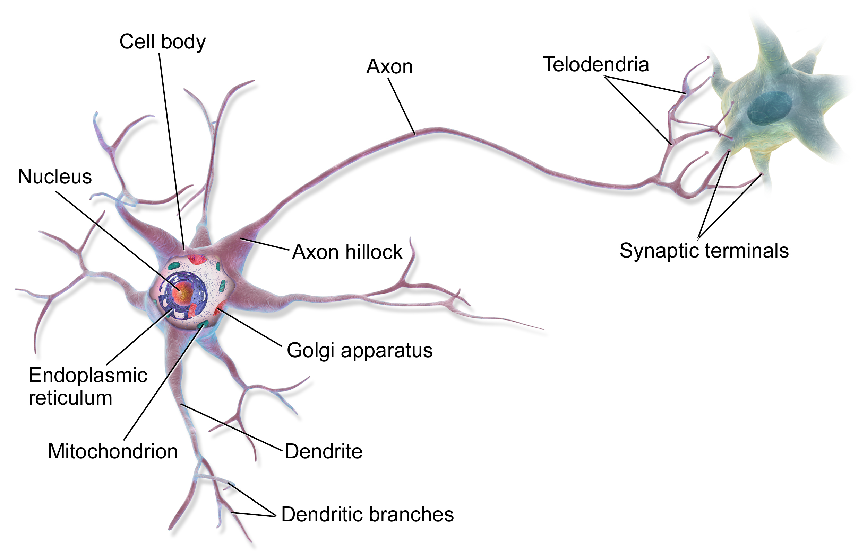
DATA SCIENCE TERMINOLOGIES: DATA SCIENCE – NEURAL NETWORKS
Copyright © 2020 Exceed Philippines. All rights reserved
Google Images: “neuron”

Slide 38

DATA SCIENCE TERMINOLOGIES: DATA SCIENCE – NEURAL NETWORKS
Copyright © 2020 Exceed Philippines. All rights reserved
Google Images: “neural network”

Slide 39
DATA SCIENCE TERMINOLOGIES: DATA SCIENCE VS ARTIFICIAL INTELLIGENCE
Artificial intelligence (AI), the ability of a digital computer or computer-controlled robot to perform tasks commonly associated with intelligent beings
Copyright © 2020 Exceed Philippines. All rights reserved
britannica

Slide 40
DATA SCIENCE TERMINOLOGIES: DATA SCIENCE VS ARTIFICIAL INTELLIGENCE
Artificial intelligence (AI), the ability of a digital computer or computer-controlled robot to perform tasks commonly associated with intelligent beings
Copyright © 2020 Exceed Philippines. All rights reserved
britannica

Slide 41
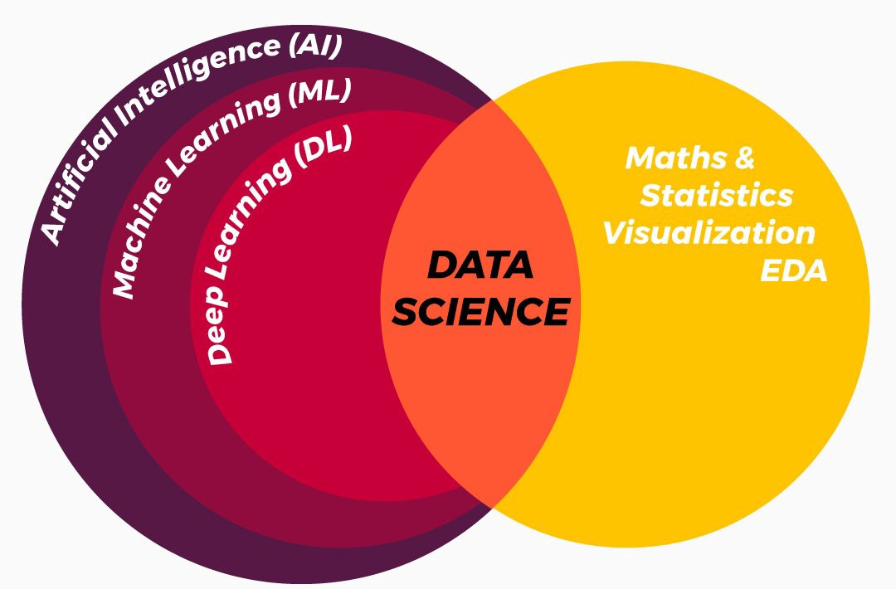
DATA SCIENCE TERMINOLOGIES: DATA SCIENCE VS ARTIFICIAL INTELLIGENCE
Copyright © 2020 Exceed Philippines. All rights reserved
Google Images “data science vs artificial intelligence”

Slide 42

JUPYTER: JUlia, PYthon, and R
Copyright © 2020 Exceed Philippines. All rights reserved

Slide 43
CARE AND SHARE!
Copyright © 2020 Exceed Philippines. All rights reserved

Slide 44
DATA SCIENCE BOOTCAMP
Session 1: Data Science Terms | Jupyter Notebook Demo
Copyright © 2020 Exceed Philippines. All rights reserved

